Slide 1

“A Promise You Can Count On”
3:15 – 22
Week 7
2 March 2022

Slide 2

Finishing from last week . . .

Slide 3
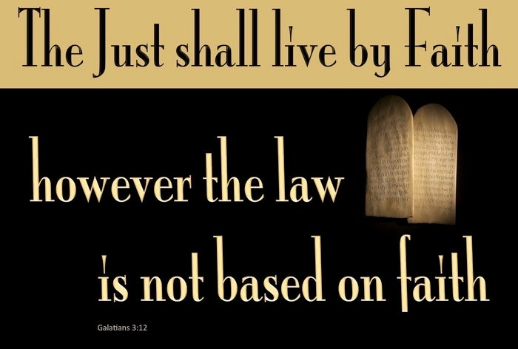

Slide 4

Galatians 3:10 – 14
Paul tells us that Christ, lived a perfectly, righteous life without even the slightest sin, nevertheless He suffered the curse of the Law (3:13). By suffering death “on a tree,” that is, a cross of wood, Jesus experienced the kind of death the Law reserves for one who is cursed.
Though Jesus Christ was the only one ever to fulfill the Law perfectly, He voluntarily submitted to a punishment associated with cursed sinners. Yet he didn’t die as a result of His own sin, but as a substitute for those who actually deserved such punishment—you and me.
The Greek word for “redeemed” in 3:13, is related to the Greek word for “marketplace” which refers to purchasing or ransoming a person, as a slave might be purchased from the slave market.

Slide 5
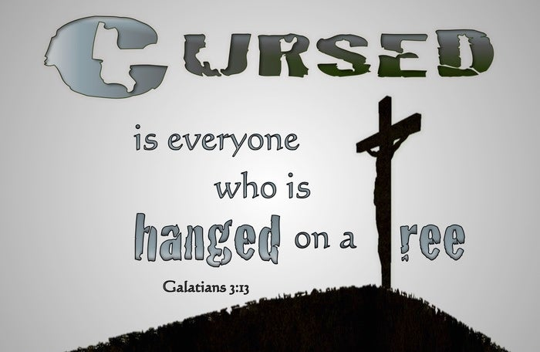

Slide 6
Galatians 3:10 – 14
The eternal Son of God—sinless, glorious, holy—slipped out of His perfect heaven and into a sin-infested world. He voluntarily took what we deserved, the judgment of God against sin, and gave us what we could never earn: a right standing before God. Why? Paul closes this section with two reasons for the steep price Christ paid to purchase those who believe.
First – Christ purchased us to bestow upon us the blessing of salvation promised to Abraham in Genesis 12:3.
Second – Christ redeemed us so that He could grant us the gift of the Holy Spirit through faith.
To backslide into legalism would be an affront to the gospel and to the God who alone saves us by His grace.

Slide 7

A Promise You Can Count On

Slide 8
Galatians Background
We live in a world of broken promises . . . from missed appointments to divorces, from missed payments to bankruptcies, we have all experienced the pain of broken promises.
Even though the whole fabric of our society rests on people keeping their word, more and more we see the threads of that fabric wearing thin as broken promises lead to broken relationships and broken lives.
Sadly, a person’s word is only as good as the person’s character and capacity. Only a person with both the integrity and the ability to fulfill a promise can be completed trusted. But if a person is weak in integrity or lacks ability because of his or her circumstances, the promise may be broken.

Slide 9
Galatians Background
To see both perfect character and unwavering capacity. We need to turn from faulty and frail humans to a faultless and powerful God. Only God can and will keep all His promises to His people.
Nothing, not even our disobedience, can invalidate his unconditional promises. In Galatians 3:15-22, Paul explains the impact of God’s timeless trustworthiness on our salvation and Christian lives.
In doing so, he gives yet another reason why we must reject legalism’s flawed promise that blessings will come through keeping the Law.

Slide 10
Galatians 3:15 – 18
¹⁵Brothers and sisters, let me take an example from everyday life. Just as no one can set aside or add to a human covenant that has been duly established, so it is in this case. ¹⁶The promises were spoken to Abraham and to his seed. Scripture does not say “and to seeds,” meaning many people, but “and to your seed,” meaning one person, who is Christ. ¹⁷What I mean is this: The law, introduced 430 years later, does not set aside the covenant previously established by God and thus do away with the promise. ¹⁸For if the inheritance depends on the law, then it no longer depends on the promise; but God in his grace gave it to Abraham through a promise.

Slide 11
Galatians 3:15 – 18
Even if Paul’s opponents admitted that Abraham was justified by faith, the Judaizers might have argued that the Law, coming at a later time, entirely changed the basis for achieving salvation. To refute this, Paul declared that just as a properly executed Roman covenant (or will) cannot arbitrarily be set aside or changed, so the promises of God are immutable.
Paul compares the Law to a human contract: “When two people make a contract, it is illegal for a third party to step in and change it or cancel it. Now, God made a contract (covenant) with Abraham 430 years before the Law was given. The law of Moses could never cancel God’s original promise to Abraham. God gave that promise to Abraham’s seed as well, and this Seed is Christ (3:16).

Slide 12
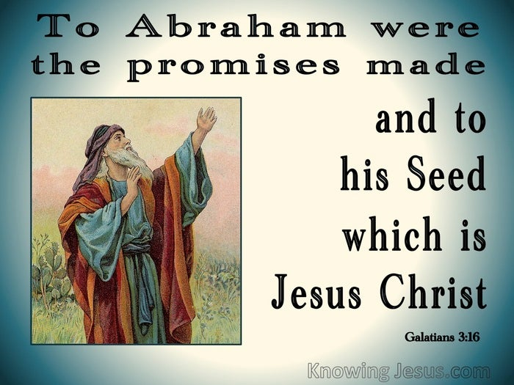

Slide 13
Galatians 3:15 – 18
The stress on seed (cf. Gen. 12:7), not seeds, was made simply to remind the readers that the faithful in Israel had always recognized that the blessing would ultimately come through a single individual, the Messiah.
The Mosaic law was not a new way of salvation that canceled God’s promises to Abraham; this would not be logical. Promise and faith go together, but not promise and law.“ The Judaizers might ask, “but why then did God even give the Law?” Paul has three answers:
1] The Law was temporary and only for Israel (19-20).
2] The Law convicts of sin but never saves from sin (21-22).
3] The Law prepared the way for Christ (23-29).

Slide 14
Galatians 3:15 – 18
Once God ratified the covenant officially, it had lasting authority so that nothing and no one could annul it. The Abrahamic Covenant was unilateral (God made the promise to Himself), eternal (it provided for everlasting blessing), irrevocable (it will never cease), unconditional (in that it depended on God, not man), but its complete fulfillment awaits the salvation of Israel and the millennial kingdom of Jesus Christ.
Paul again emphasized that there is no middle ground between law (works) and promise (grace); the two principles are mutually exclusive ways of salvation. An “inheritance” by definition is something granted, not worked for, as proven in the case of Abraham (3:18).

Slide 15
Galatians 3:15 – 18
It was not until 430 years after the promise to Abraham that God gave his people the law. At Mount Sinai God gave Moses the Ten Commandments and the many lesser regulations for a godly society.
But the law didn’t replace the promise. Nor did the fulfillment of the promise depend on keeping the law.
With God, a promise is a promise. He always keeps his word. The promise is fulfilled in Jesus Christ and all who belong to him.

Slide 16
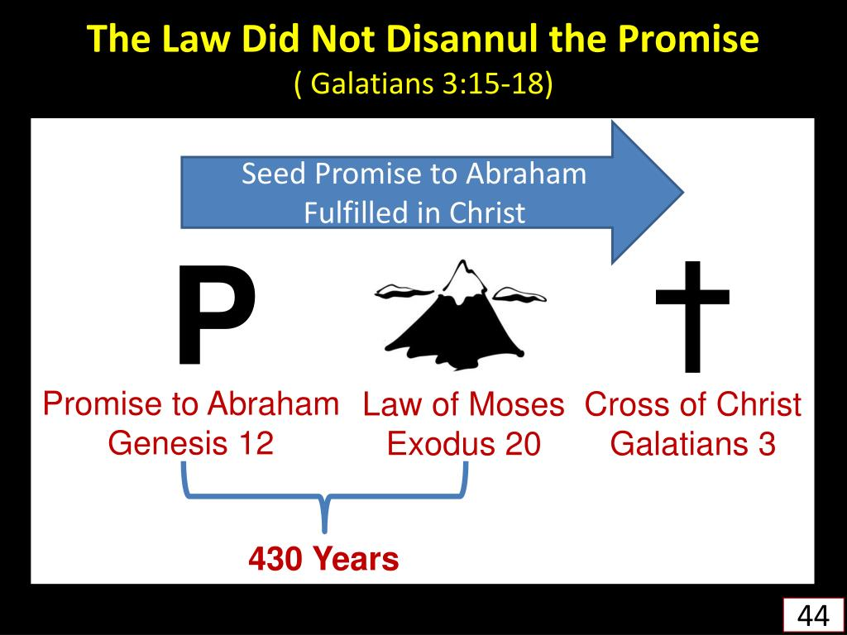

Slide 17
Galatians 3:19 – 20
¹⁹Why, then, was the law given at all? It was added because of transgressions until the Seed to whom the promise referred had come. The law was given through angels and entrusted to a mediator. ²⁰A mediator, however, implies more than one party; but God is one.

Slide 18
Galatians 3:19 – 20
Having shown the superiority of the promise to Abraham (3:15–18), Paul described the inferiority of the law, and its purpose. Paul’s persuasive argument that the promise is superior to the law raises an obvious question: “Why, then, was the law given at all?”
FIRST – the Law was given because of transgressions, that is, it was given to be a means for checking sins. When there was no law, we had no idea what sin was. But once the law was given, it became clear that we were in deep trouble. The law shows our sin and our need for God’s forgiveness.
It served as a restrainer of sins by showing them to be transgressions of God’s Law which would incur His wrath—it was never intended to be the way of salvation.

Slide 19
Galatians 3:19 – 20
SECOND – the Law was temporary and served until the Seed (the Messiah) came, after which it was no longer needed.
THIRD – the Law was inferior because of the manner of its bestowal. While God made promises to Abraham directly, the Law was established by a mediator. There were in fact two mediators, the angels representing God, and Moses representing the people.
Paul’s point is apparently that a “mediator” is required when more than one party is involved, but God alone ratified the covenant with Abraham. That is, when God gave the promise, he gave it “first-hand” from Himself to Abraham.

Slide 20
Galatians 3:19 – 20
The Bible teaches that angels were involved in the giving of the law, but does not explain the precise role they played (cf. Heb. 2:2 > “For since the message spoken through angels was binding, and every violation and disobedience received its just punishment” ).

Slide 21
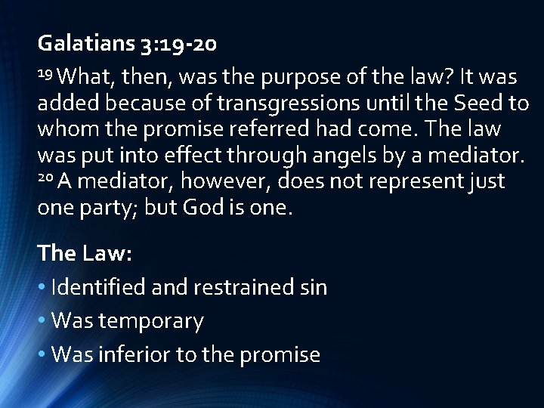

Slide 22
Galatians 3:21 – 22
²¹Is the law, therefore, opposed to the promises of God? Absolutely not! For if a law had been given that could impart life, then righteousness would certainly have come by the law. ²²But Scripture has locked up everything under the control of sin, so that what was promised, being given through faith in Jesus Christ, might be given to those who believe.

Slide 23
Galatians 3:21 – 22
Another question is raised: Is there conflict between the Law and the promises of God? “God forbid” or “Perish the thought,” declares the apostle.
Here, Paul uses the strongest Greek negative to disdain the idea that the law and the promise are at opposite purposes. God gave both the Law and the promise, but for different purposes. And since God gave them both and does not work against Himself, the law and promise work in harmony. But only the promise can give us life.
The law shows us our sinfulness and shuts us in a prison of guilt — so that we long for the salvation freely offered in the promise. If the law could have provided righteousness and eternal life, there would be no need for the gracious promise.

Slide 24
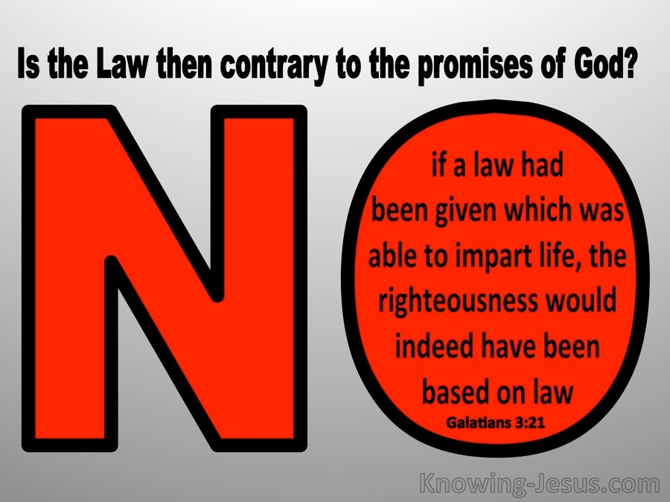

Slide 25
Galatians 3:21 – 22
Again, the Law is not opposed to the promises, and since there is no conflict between them, how can their harmony be demonstrated? By recognizing that while the Law could not justify or give life, it did prepare the way for the gospel.
What part then did Law play in this respect? It declared the whole world a prisoner to sin. Paul declared that the whole world is trapped and under the dominion of sin (cf. Rom. 3:23). When people recognize this and give up attempts to please God by their own works, the way is prepared for them to receive the promise of salvation through faith in Jesus Christ.

Slide 26
Galatians 3:21 – 22
The Jewish Christians (Judaizers) who want Gentiles to be circumcised are assuming that the law is more important than the promise. They are assuming that faith can only be expressed by keeping the rules and regulations of the Jewish law. Paul says the opposite.
All the demands of the law have been met by the death of Jesus on the cross. Now the main line of God’s righteousness is absolutely clear. It is free to all through faith in Christ.

Slide 27

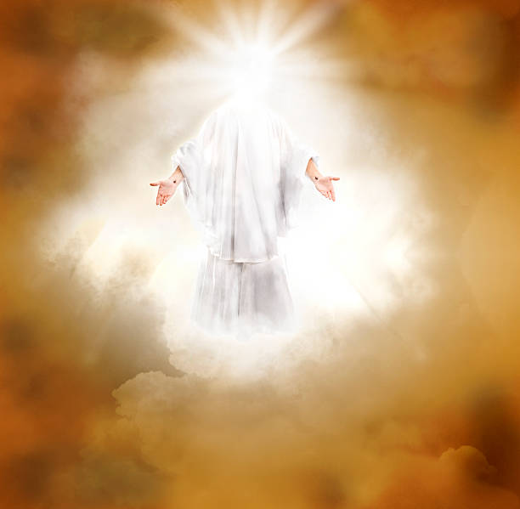

Slide 28
NEXT CLASS – 9 March 2022
Book of Galatians
Before next class, read the below verses in the KJV and the NIV, plus one additional versions of the Bible, i.e., NRSV, NLT, NKJV, etc …
Chapter 3:23 – 4:11
“From Law To Faith”
EBC Website for Handouts
https://bit.ly/surveyofpaulineepistles

